Slide 1
The battle of Neighborhoods
Exploring the venues in Dubai.

Slide 2
Introduction
This project explores various venues in Karama area of Dubai and attributes the data based on user ratings and average price.
To explore this information, this project involves the juxtaposition of both the Foursquare API and the Zomato API to fetch complete information of various venues (including name, address, category, rating, and price).
Recommends restaurants for category of people according to their budget.

Slide 3
Data Acquisition and Cleaning
From Foursquare API (hhttps://developer.foursquare.com/docs/api), I retrieved the following for each venue:
Name: The name of the venue.
Category: The category type as defined by the API.
Latitude: The latitude value of the venue.
Longitude: The longitude value of the venue

Slide 4
From Zomato API (https://developers.zomato.com/api), I retrieved the following for each venue:
Name: The name of the venue.
Address: The complete address of the venue.
Rating: The ratings as provided by many users.
Price range: The price range the venue belongs to as defined by Zomato.
Price for two: The average cost for two people dining at the place. I later convert the same to average price per person by dividing by 2.
Latitude: The latitude value of the venue.
Longitude: The longitude value of the venue.

Slide 5
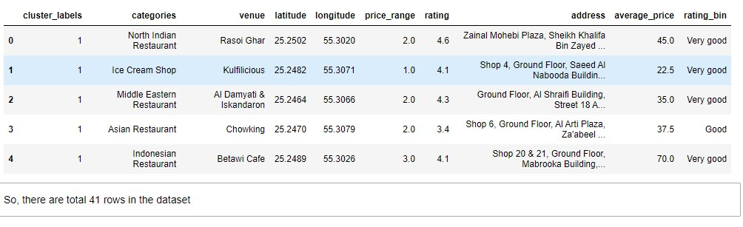
To combine the two datasets, I had to check that the latitude and longitude values of each corresponding venue match.
After careful inspection and removal, the final dataset had a total of 50 venues with which we can work.
As a final dataset, we’re left with 41 venues with 8 columns as described in figure

Slide 6
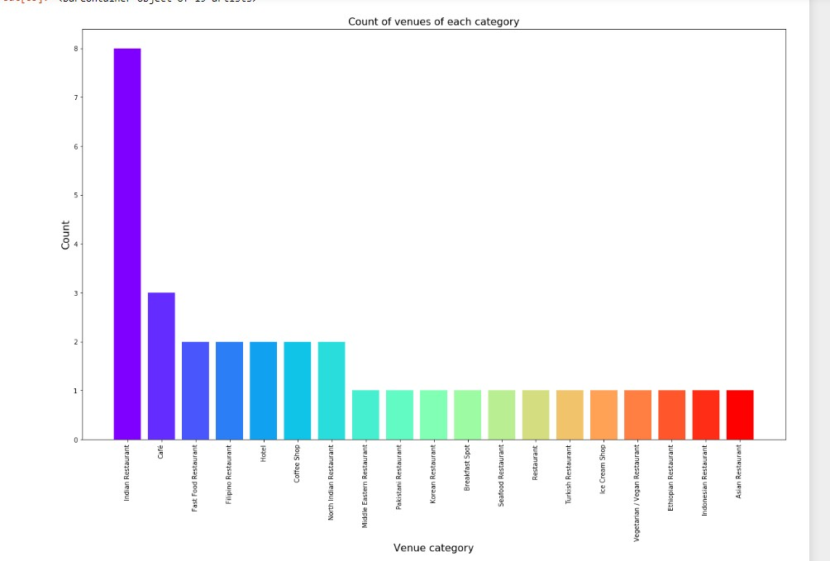
Methodology and Exploratory Data Analysis

Slide 7
From figure2 from the previous slide, we see that the majority venues are actually Indian Restaurants. This is closely followed by Filipino Restaurants. For someone who is visiting this place in Dubai and loves Indian Restaurants, they’d surely love their stay.
Next, I’ll explore the ratings of various venues in Karama,Dubai. I decided to plot a bar chart with x-axis as the rating from 1 to 5 and the y-axis as the count of venues with that rating. I decided to plot the bar chart to see what average rating venues get in Karama, Dubai. This can be seen in figure 3.

Slide 8
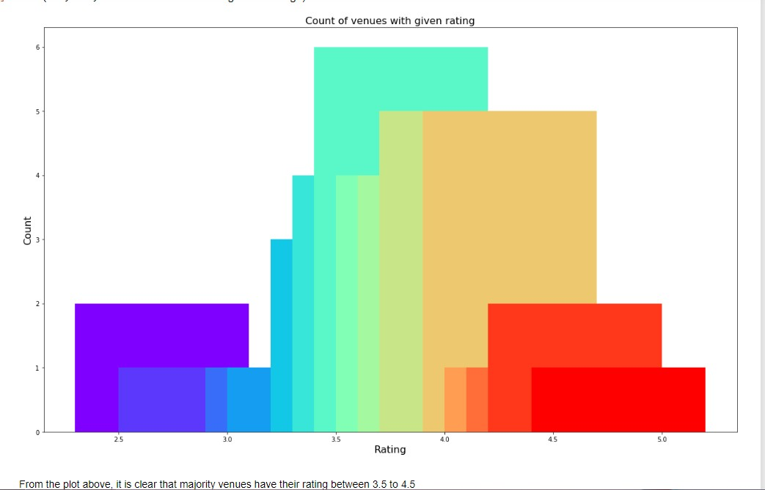
Rating and count of venues with that rating

Slide 9
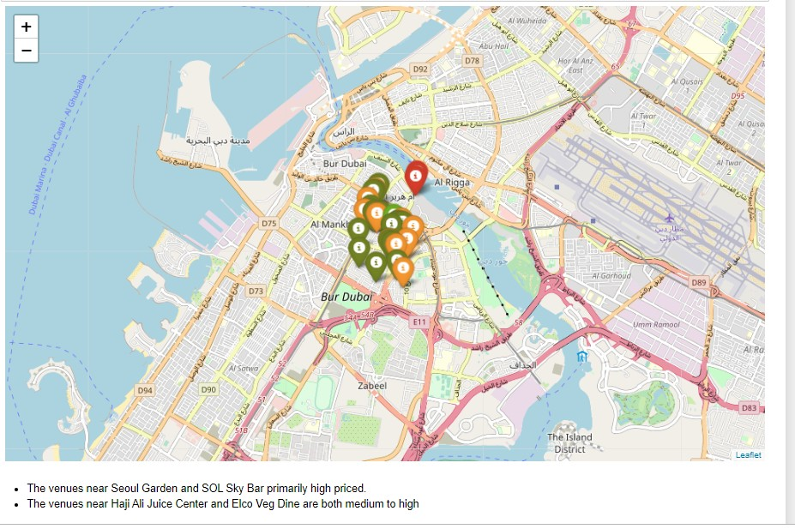
Plot of venues with different prices

Slide 10
Observation of the previous map
The venues near Seoul Garden and SOL Sky Bar primarily high priced.
The Venues near Kulfilicious is medium priced.
The venues near Haji Ali Juice Center and Elco Veg Dine are both medium to high

Slide 11
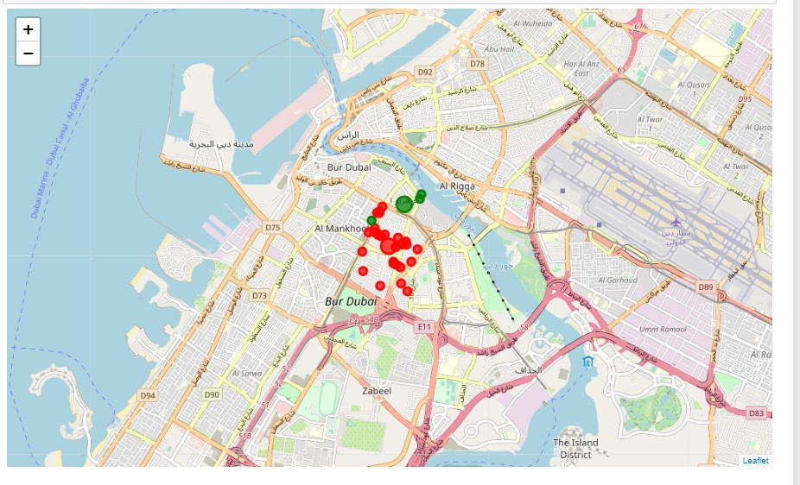
Clustering
Finally, I cluster all the venues based on their price range, location and more to identify similar venues and the relationship amongst them. I used KMeans clustering and decided to cluster the venues into two separate groups.

Slide 12
Observations from the map of clustering
The first cluster (green) is very sparse includes the very few venues. These venues have mean price range of 200 dirham and rating spread around 4.
The second cluster (red) is dense spread across wide and has very many venues. These venues have mean price range of 50 dirhams and rating spread around 3.5 to 4.5.

Slide 13
Conclusion
The purpose of this project was to explore the restaurants around Karama that a person visiting Dubai could visit.
The venues have been identified using Foursquare and Zomato API and have been plotted on the map.
The map reveals that there are three major areas a person can visit in Karama area in Dubai: Kulfilicious or Burjuman Mall, Elco Veg Dine and Sol Sky Bar . Based on the visitor's venue rating and price requirements, he/she can choose amongst the three places.

